Slide 1
How DNS works?
Aniruddha Malkar
Network Engineer

Slide 2
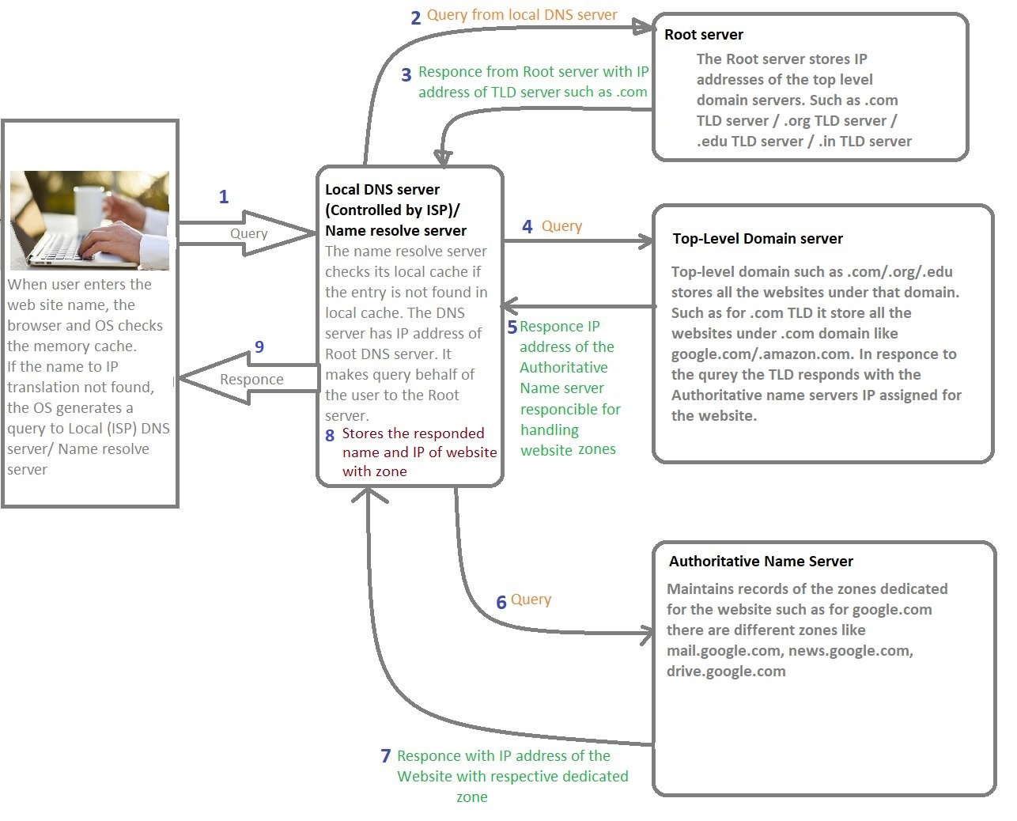
DNS Query

Slide 3
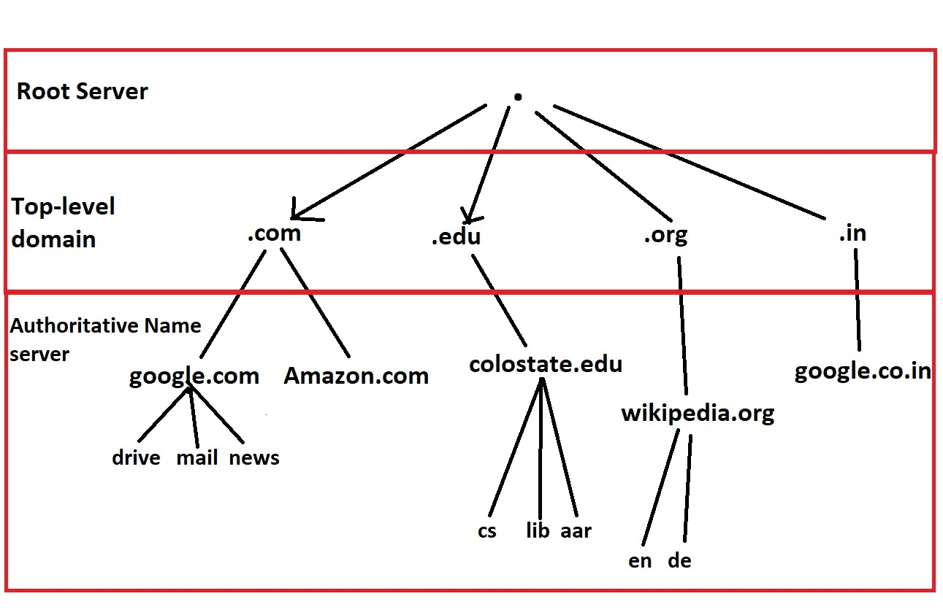
DNS Tree

